Slide 1
Commercialisation of
IoT Technology

Slide 2
IoT for business and enterprise use
IoT enables new smart products to
  address market needs
  make better versions of the existing products
  create a solution that nobody else provides

Slide 3
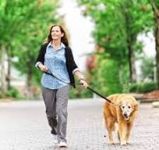
Example
Can we put a sensor on our pet? Yes, why not. But, what for? (business opportunity)
Is it feasible? How would that work? (UX)
Monetisation (data driven products)
IoT sensor on dog collar

Slide 4
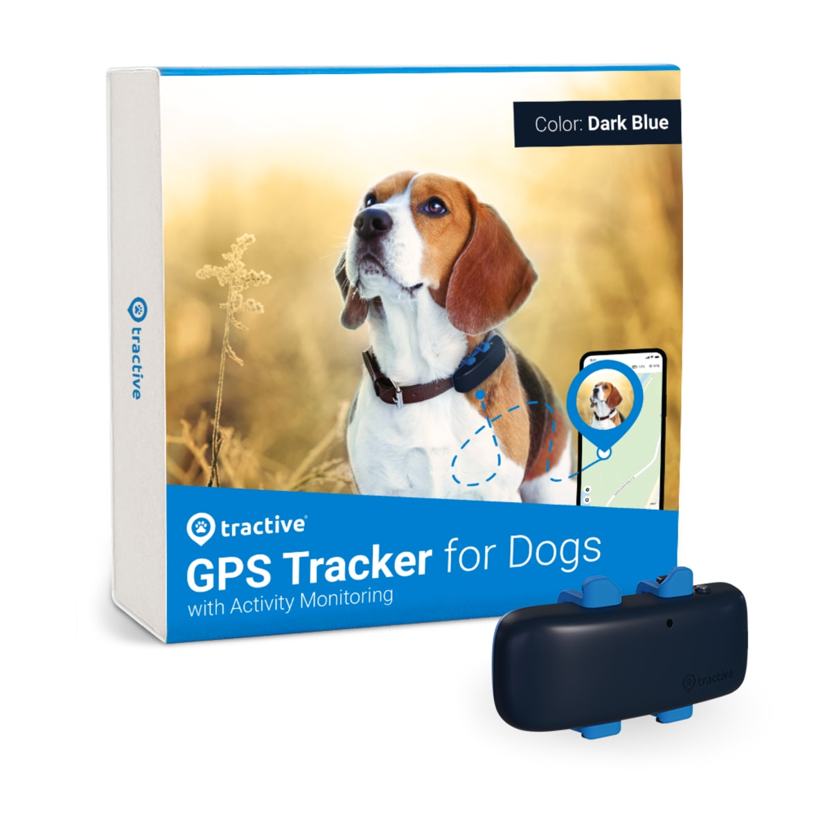
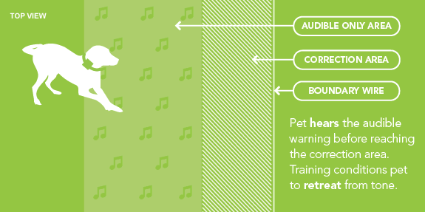
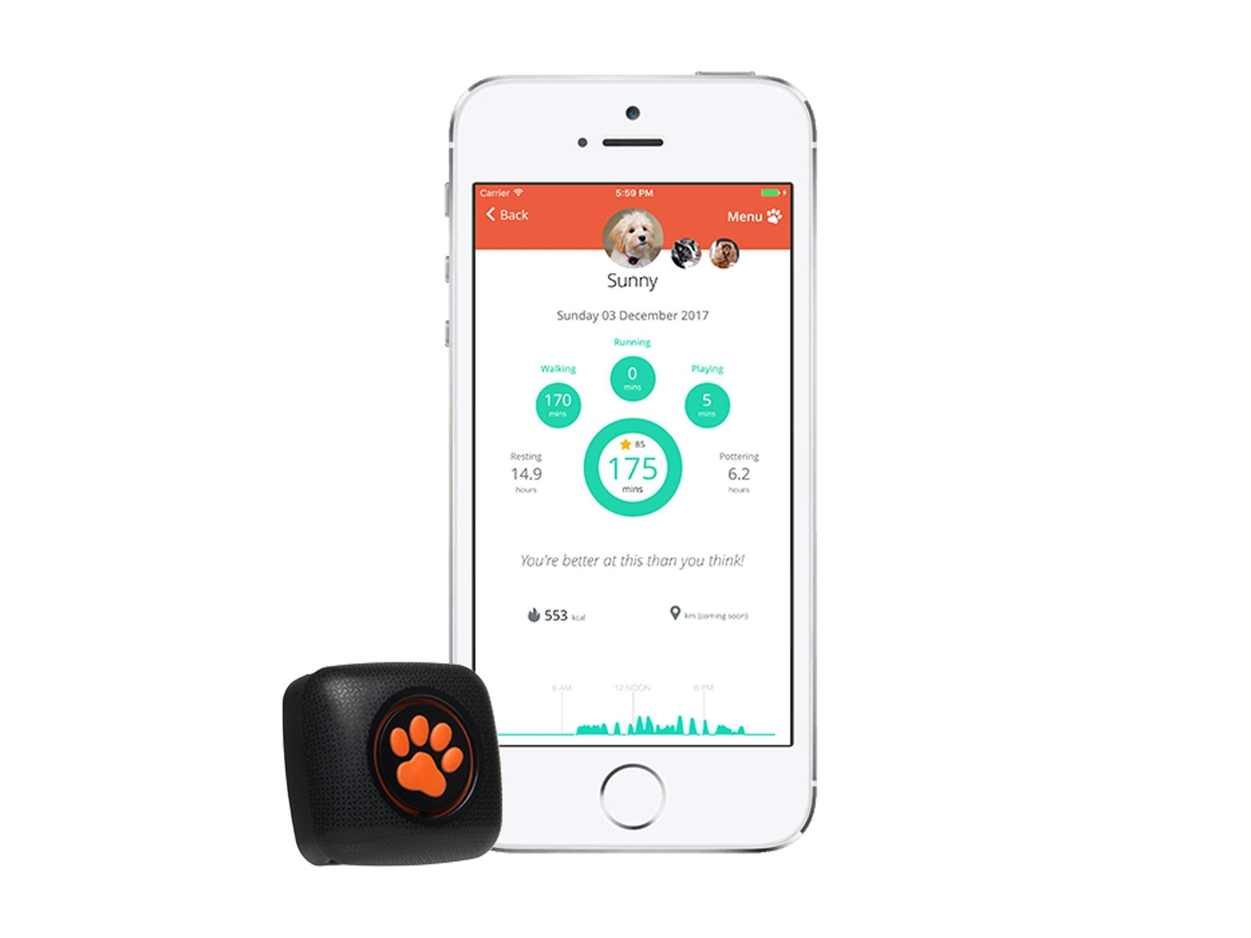
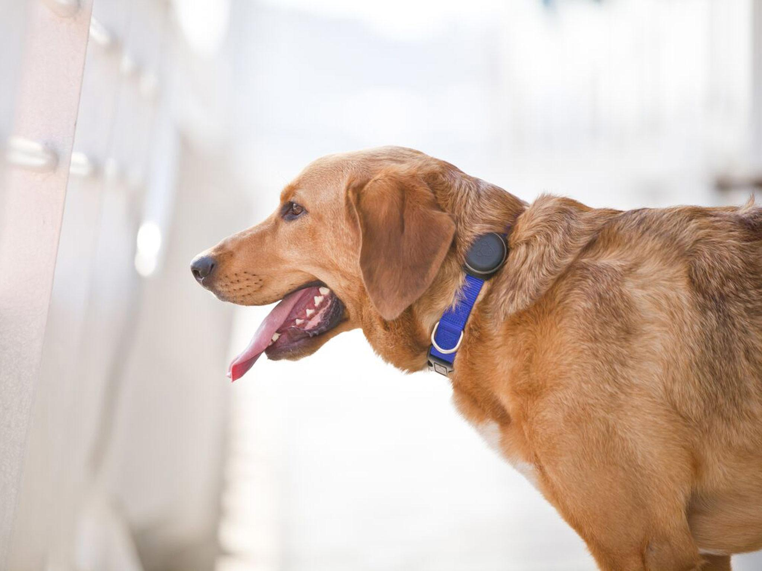
Example: business opportunity (what for?)
location
fencing
IoT sensor on dog collar
sleep/play time management
exercise goals

Slide 5
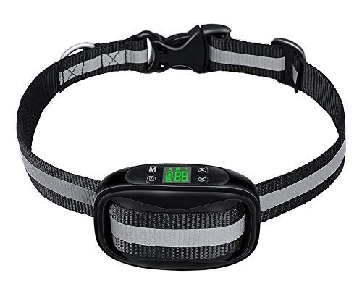
Example: User experience
Firmware/Software
USB
NFC (centimetres)
BLE (metres)
Wi-fi
4G/LTE/5G
OTA
etc
Hardware
Re-charge battery
Battery life
Water-proof
Child-proof
Etc

Slide 6
Example: monetisation
Who’s going to use / pay for this data? Here’s where data gets transformed into gold.
Pet owner (dog activity, location, fencing, etc)
Pet insurance
Proxy for owner’s lifestyle (health insurance / life insurance)
Plan vet visits
Food preference
IoT sensor on dog collar

Slide 7
Lab work
Think of an activity or sport
  What can you instrument or add a tech gadget to?
  What’s the business opportunity?
  How does the UX look like?
  What data monetisation opportunities you see?
Provide details and justifications with your answers!

